Slide 1

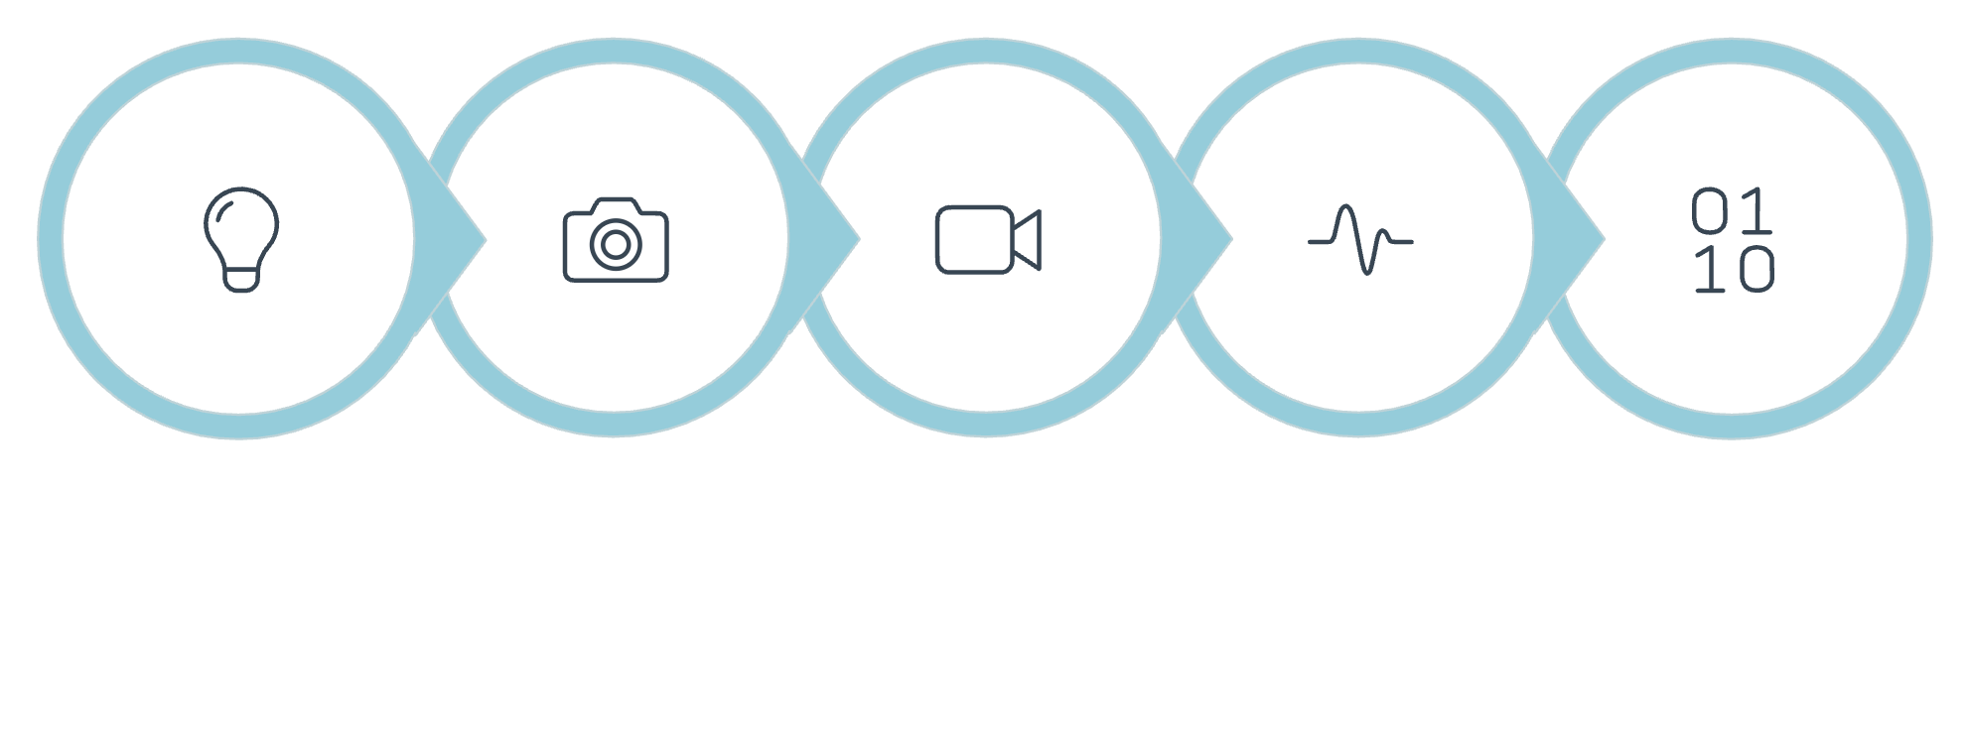
Optical Camera Communication (OCC)
Video Message Decoding Using Computer Vision, Signal Processing & Machine Learning
AI/ML Research Project
TIH, IIT Guwahati
4-Week Online Internship
Project Supervisor: T. Vamsikrishna
Presentation by: Santhosh Reddy
Faculty/Domain Expert
Dr. AVR Murthy, OCBL, DIAT
LED Source
Camera
Video
Signal
Binary Data

Slide 2
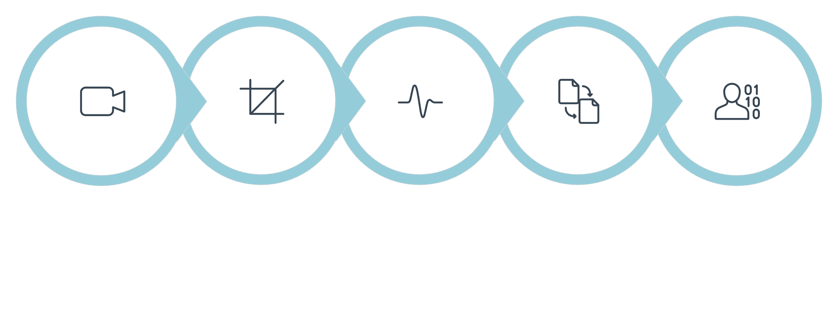
Problem Statement & Motivation
Problem Statement
Main Challenge
Optical Camera Communication uses variations in the intensity of a light source to transmit digital information. A standard camera captures these variations as video frames.
In this project, the videos contain On-Off Keying (OOK) encoded information. The goal is to recover the changing light intensity from the video, synchronize the signal with transmitted symbols, decode the binary sequence, and reconstruct the original message.
The captured signal can be affected by:
Camera motion
Ambient illumination
Image/video noise
ROI/transmitter localization
Timing and synchronization errors
Weak ON/OFF intensity differences
Video
ROI
Intensity
Sync
OOK Decode

Slide 3

Project Objectives
What I Aim to Achieve
1
Understand and formulate the OCC video decoding problem.
2
Inspect and prepare the provided video dataset.
3
Detect/select the transmitter Region of Interest (ROI).
4
Extract and analyze temporal light-intensity signals.
5
Compare threshold-based, signal-processing and ML-assisted approaches.
6
Evaluate decoding accuracy, BER, synchronization robustness and failure cases.
Goal: Build a reliable and reproducible video-to-message decoding pipeline.

Slide 4
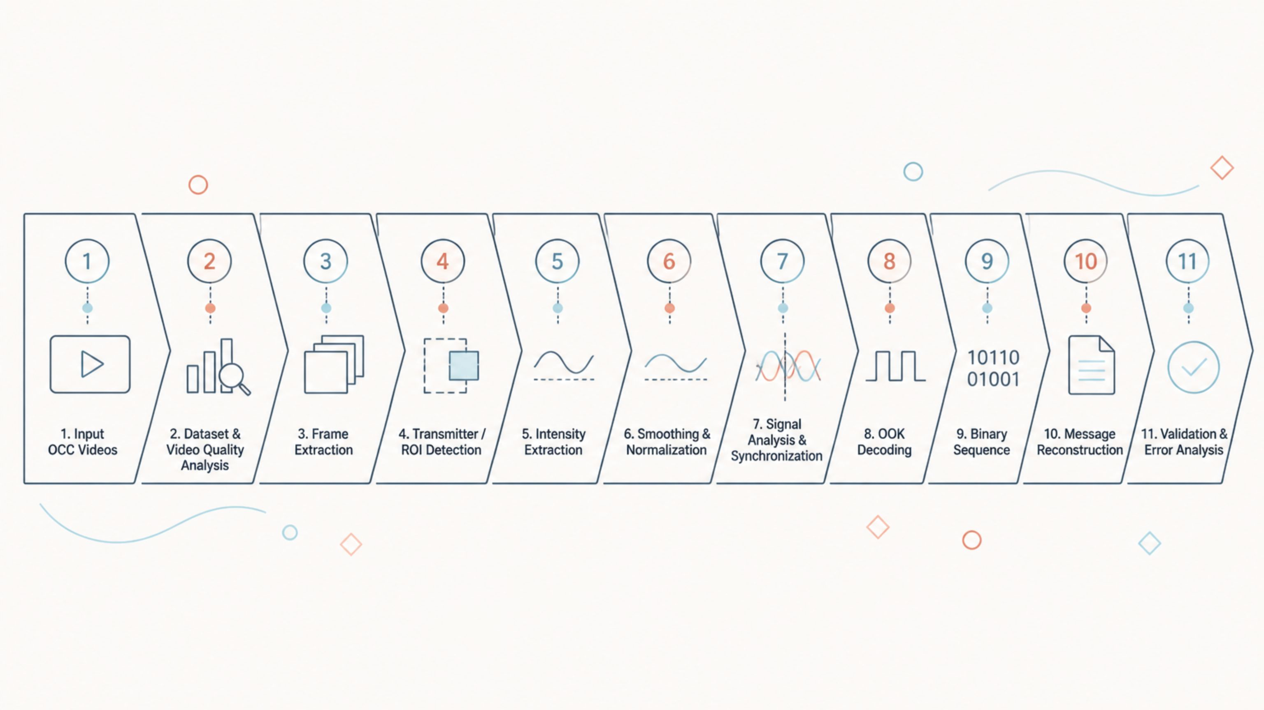
Proposed Methodology / Workflow
Approach: Baseline first → Advanced methods/ML next → Compare → Select final approach. The project is software-only and dataset-driven.

Slide 5
Literature Review
Related Research
Work
Problem
Method
Key Contribution
Relevance
Pathak et al. (2015) — IEEE GLOBECOM
OCC channel modeling
Experimental measurement
Characterized OCC channel under various conditions
OCC fundamentals
Chow et al. (2016) — IEEE Photonics Journal
LED-to-camera VLC
OOK modulation, camera receiver
Demonstrated practical LED-to-camera link
OOK-based OCC
Danakis et al. (2012) — IEEE GLOBECOM
Rolling-shutter OCC
Smartphone camera receiver
Exploited rolling shutter for high data rates
Camera-based VLC
Luo et al. (2018) — IEEE Access
OCC synchronization
Frame-based sync pattern
Proposed robust symbol synchronization method
Signal synchronization
Nguyen et al. (2020) — IEEE TWC
OCC receiver design
ROI selection, signal extraction
Optimized ROI detection for OCC receivers
ROI & signal extraction
Wang et al. (2021) — IEEE IoT Journal
ML-assisted OCC
Neural network classifier
Applied deep learning to OCC symbol detection
ML-assisted optical comm.
Yamaguchi et al. (2017) — IEEE ICC
LED identification via camera
Intensity modulation, image processing
Multi-LED OCC system with spatial separation
LED-to-camera comm.
Suparna et al. (2019) — IEEE VTC
OCC under ambient light
Adaptive thresholding
Improved robustness against ambient illumination
Signal recovery
Research Gap
Existing work demonstrates camera-based optical communication and signal recovery, but this project focuses on building a reproducible offline software pipeline for decoding provided OOK-encoded OCC videos, with explicit analysis of ROI selection, temporal signal extraction, synchronization, robustness and ML-assisted decoding.

Slide 6

Candidate ML & Signal-Processing Methods
A. Baseline
B. Classical ML
Fixed threshold OOK decoding
Adaptive thresholding
Smoothing
Normalization
Transition detection
Symbol synchronization
Potential candidates:
Logistic Regression
Decision Tree
Random Forest
SVM
KNN
C. Sequential / Deep Learning
If the dataset and labels support them:
1D CNN
LSTM / GRU
Important note: These are candidate methods, not final selections. Final selection should depend on: Data characteristics + validation performance + robustness + computational cost
Best Approach
Baseline
Feature Prep
ML Models
Comparison

Slide 7

Expected Dataset Structure & Data Challenges
Expected Dataset Structure
Possible Data Challenges
Clearly state that the exact schema will be confirmed after dataset inspection.
Possible video-level information:
Missing or corrupted frames
Variable video quality
Camera movement
Incorrect ROI detection
Ambient-light variation
Sensor noise
Timing/frame-rate irregularities
Weak ON/OFF separation
Synchronization errors
Class imbalance
Limited independent video sequences
Missing/incomplete labels
Data leakage
video_id
filename
frame rate
duration
resolution
session/transmission ID
Possible frame/signal-level information:
video_id
frame_index
timestamp
ROI coordinates
mean/median intensity
normalized intensity
Possible target information:
transmitted bit/symbol
binary sequence
decoded message
Highlight: Train/test splitting must respect video/session boundaries when frames are highly correlated.

Slide 8

Evaluation, Expected Outcome & Next Steps
Evaluation
Expected Outcome
Primary:
A reproducible pipeline that can:
Input Video → Extract Signal → Synchronize → Decode → Reconstruct Message
Decoded-message correctness
Bit Error Rate (BER)
Additional:
Immediate Next Steps
Synchronization robustness
Precision / Recall / F1 for supervised ML
Confusion matrix
Processing time
Sensitivity to ROI, smoothing, threshold and timing
Failure-case analysis
Audit the provided dataset.
Understand video properties and labels.
Extract frames and candidate ROIs.
Plot temporal intensity signals.
Establish the threshold-based baseline.
Experiment with adaptive/signal-processing methods.
Test suitable ML models where justified.
Validate and analyze errors.
No final model is assumed before data analysis.

Slide 9
Thank You
Questions & Discussion
Optical Camera Communication (OCC)
Video Message Decoding
TIH, IIT Guwahati | AI/ML Research Project

